Slide 1
Jekins pipeline
ow

Slide 2
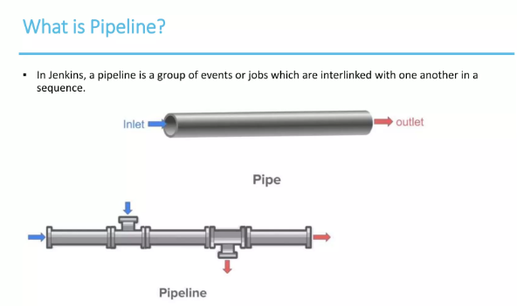
What is pipeline?

Slide 3
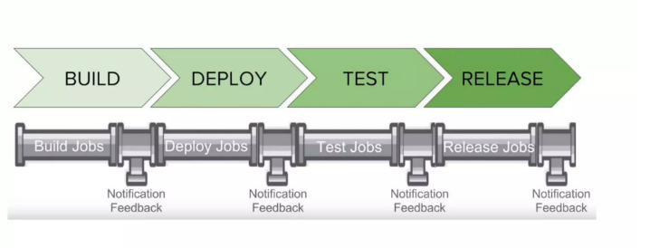
..

Slide 4
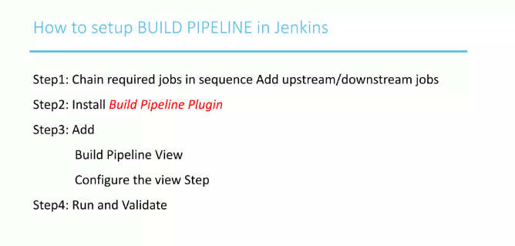

Slide 5
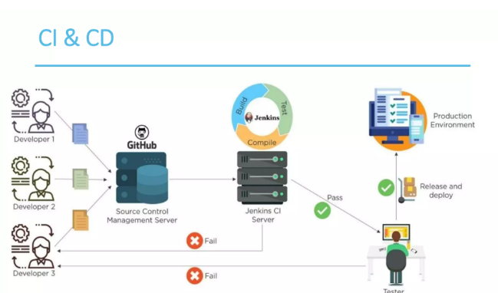

Slide 6
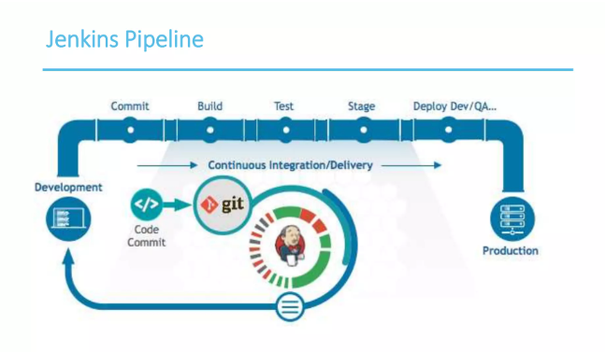
..

Slide 7
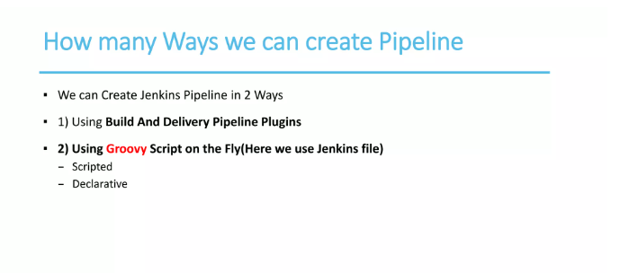
..

Slide 8
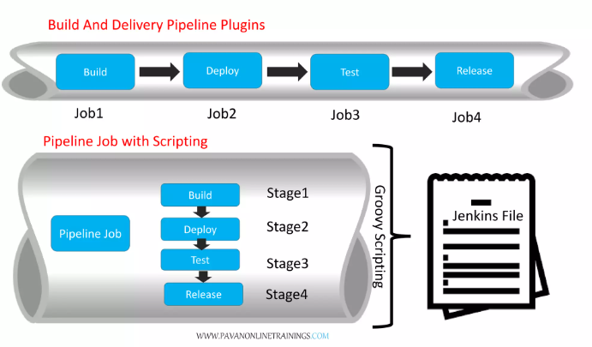
.

Slide 9
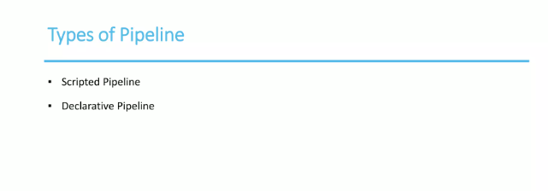
..

Slide 10
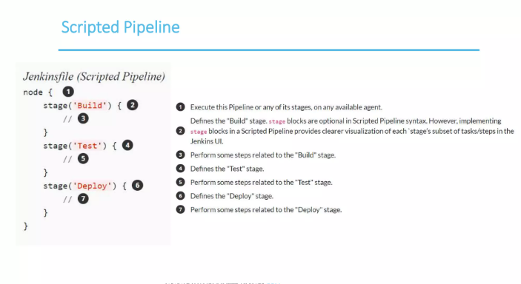

Slide 11
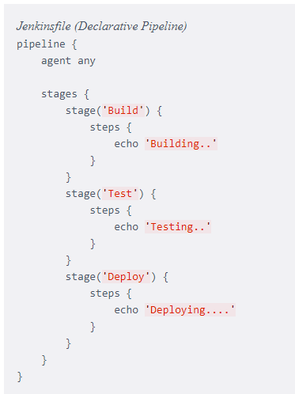
Declarative Pipeline

Slide 12
Build
For many projects the beginning of "work" in the Pipeline would be the "build" stage. Typically this stage of the Pipeline will be where source code is assembled, compiled, or packaged. The Jenkinsfile is not a replacement for an existing build tool such as GNU/Make, Maven, Gradle, etc, but rather can be viewed as a glue layer to bind the multiple phases of a project’s development lifecycle (build, test, deploy, etc) together.
Jenkins has a number of plugins for invoking practically any build tool in general use, but this example will simply invoke make from a shell step (sh)

Slide 13
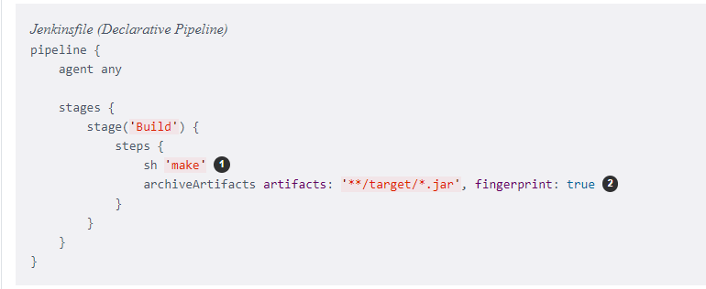
..

Slide 14
Test
Running automated tests is a crucial component of any successful continuous delivery process. As such, Jenkins has a number of test recording, reporting, and visualization facilities provided by a number of plugins. At a fundamental level, when there are test failures, it is useful to have Jenkins record the failures for reporting and visualization in the web UI.
The example below uses the junit step, provided by the JUnit plugin.

Slide 15
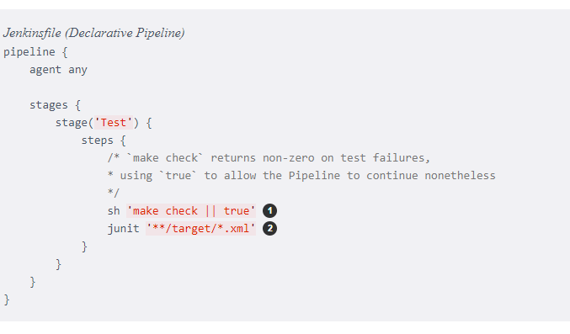
..

Slide 16
Deploy
Deployment can imply a variety of steps, depending on the project or organization requirements, and may be anything from publishing built artifacts to an Artifactory server, to pushing code to a production system.
At this stage of the example Pipeline, both the "Build" and "Test" stages have successfully executed. In essence, the "Deploy" stage will only execute assuming previous stages completed successful

Slide 17
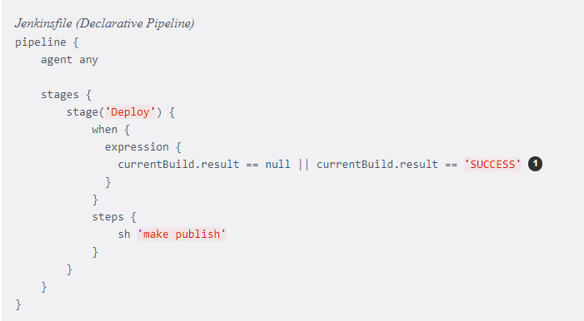
..

Slide 18
Difference
Syntax: Scripted pipelines are written in Groovy code, while declarative pipelines are written in YAML.
Flexibility: Scripted pipelines offer more flexibility and control over the pipeline execution, while declarative pipelines have a more opinionated and structured approach.
Complexity: Scripted pipelines can be more complex and difficult to maintain, while declarative pipelines are designed to be simpler and easier to understand.
Features: Scripted pipelines offer access to the full Jenkins API and can be used to implement advanced features, while declarative pipelines have a more limited set of features and are more focused on simplicity and ease of use.

